Slide 1

SCPERB:SINGLE-CELL PERTURBATION
VIA STYLE TRANSFER-BASED VAE
2023 丘成桐中学科学奖计算机组答辩
演讲者：汤子嘉 时间：2023.12

Slide 2
PART 01
Background
研究背景

Slide 3
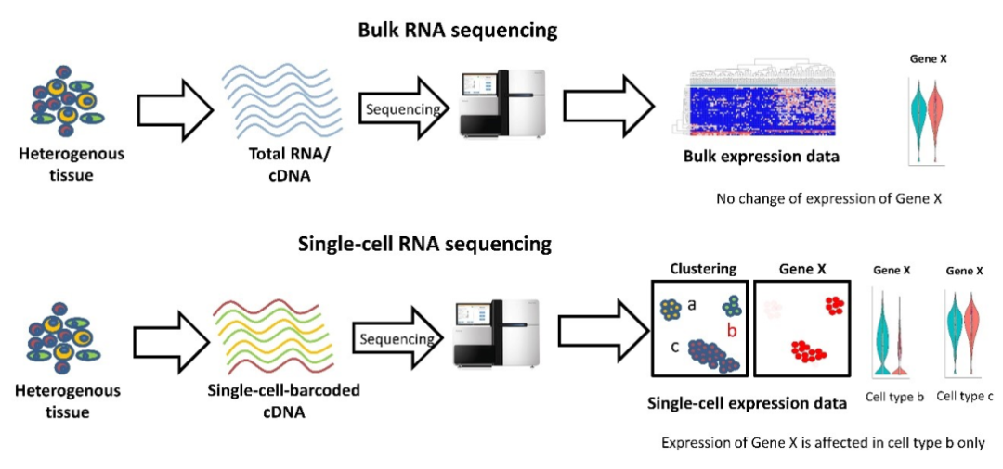
01
Background: What is single-cell?
Single-cell RNA sequencing technique
Bulk RNA sequencing technique (traditional)
Single-cell RNA sequencing technique
Source: 恒诺新知,(2021). 单细胞RNA-seq介绍

Slide 4

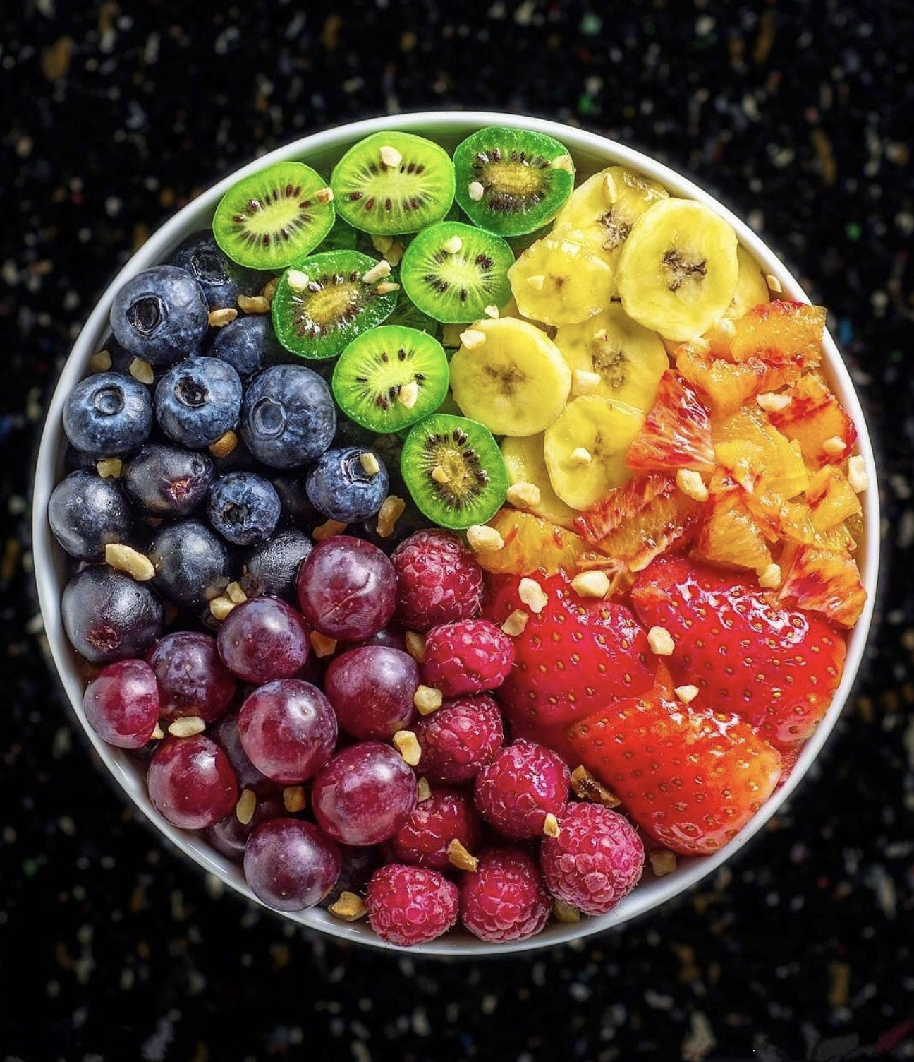
01
Background: What is single-cell?
Single-cell RNA sequencing technique
Bulk RNA sequencing technique (traditional)
Single-cell RNA sequencing technique

Slide 5
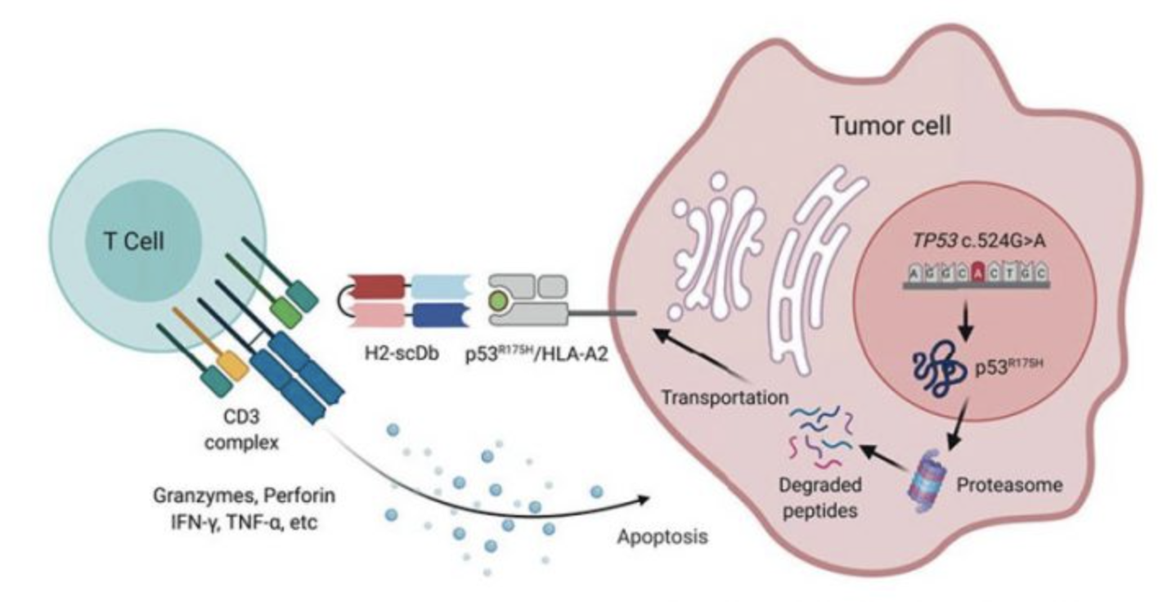
01
Background: What is perturbation?
Definition：The change of the gene expression of cells after stimulus.
And all my model did is to predict the change with a small dataset.
Source: Hsiue et al.^{[1]}

Slide 6
01
Background: Why prediction?
Why predicting perturbation?
Perturbation prediction could provide insight for curing diseases.
e.g. Testing whether a kind of new drugs could kill cancer cells or not.
Little data before clinical trials?
No problem! Just use the model to predict its effect!
Could this drug significantly decrease the gene expression of cancer cells？
Or could it significantly increase the gene expression of anti-cancer cells？
Our model could provide accurate predictions of such cases.
And provide precious data for their future studying and researches.

Slide 7
01
Background: Existing solutions
What are the existing solutions to this question?
Statistic methods: such as linear regression.
GANs: such as CGAN, WGAN, and sc-WGAN.
VAEs: such as CVAE and scGen.
What are the limitations of these solutions?
Statistic methods have poor predicting ability for non-linear cases.
GANs would provide “versatile” results, and the training process is not stable.
VAEs could result in “vague” results (i.e. could not divide control data from perturbed data).

Slide 8
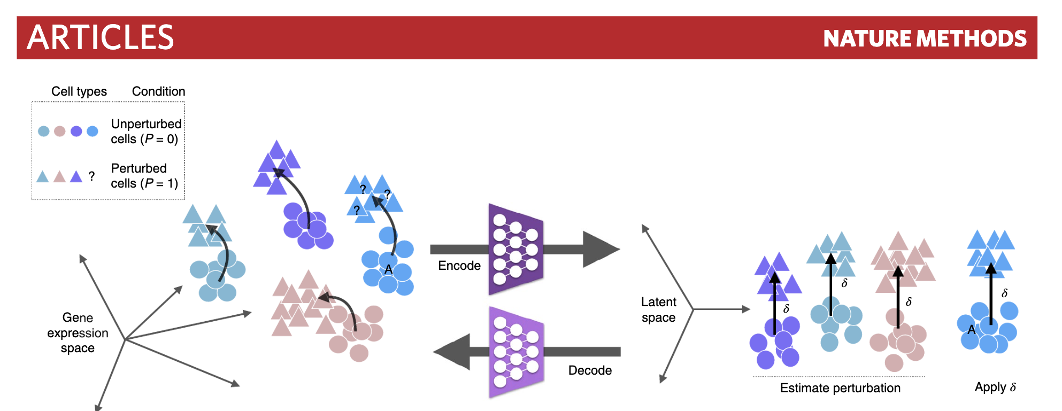
01
Background: Existing solutions
scGen
Source: Lotfollahi et al^{[2]}

Slide 9
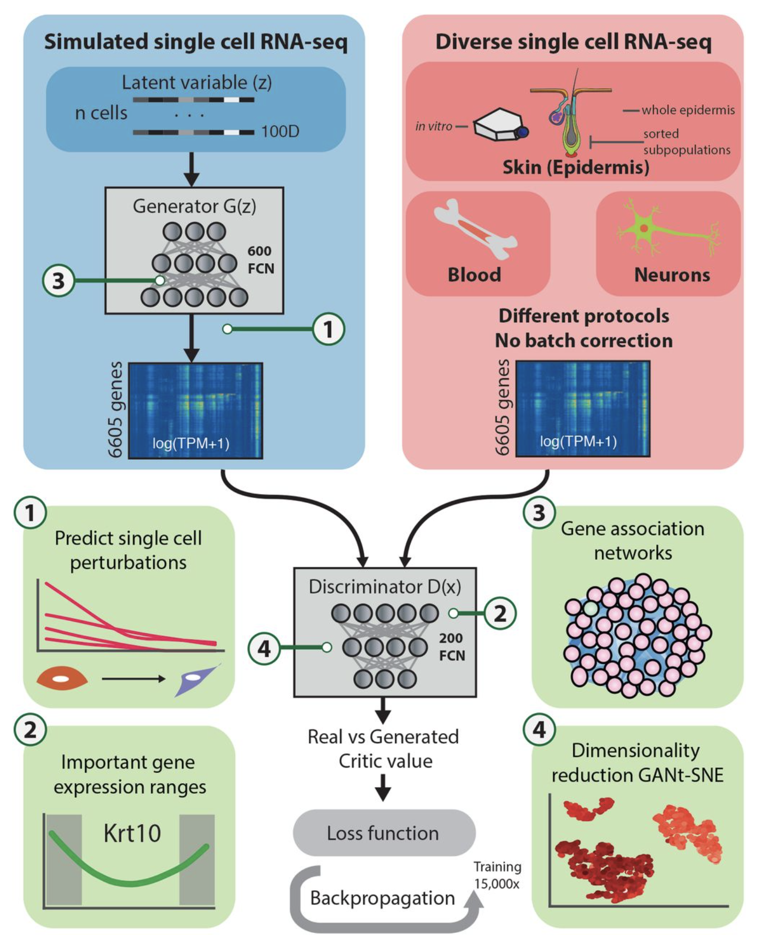
01
Background: Existing solutions
sc-WGAN
Source: Ghahramani et al^{[3]}

Slide 10
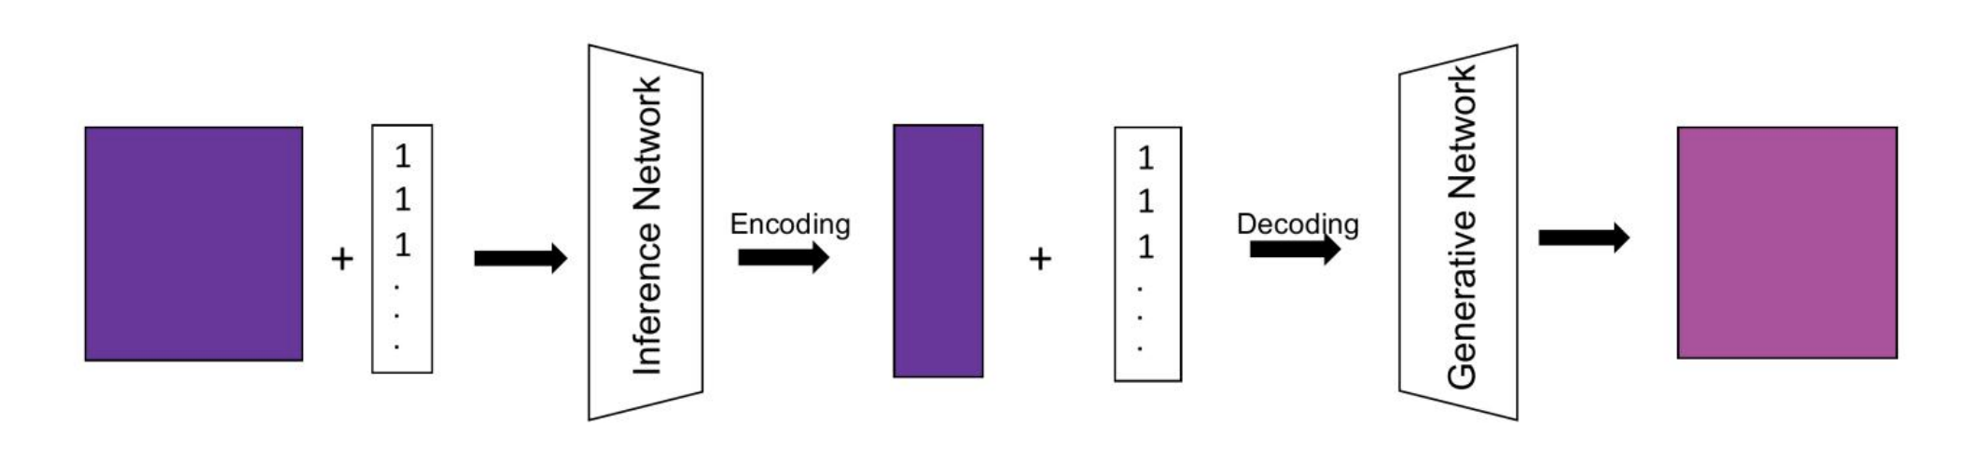
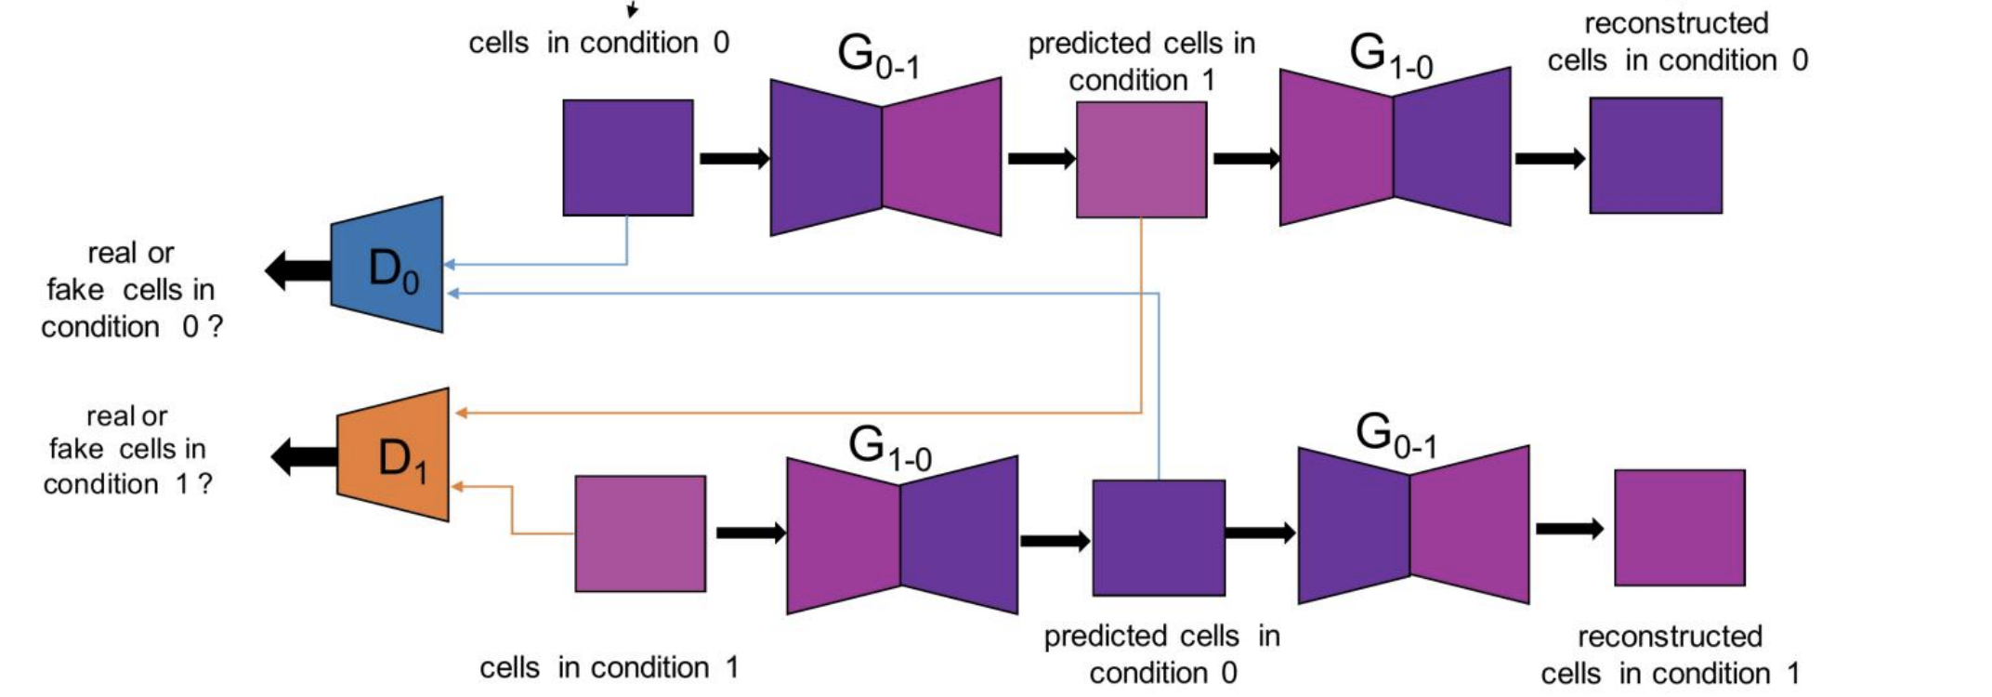
01
Background: Existing solutions
CVAE
stGAN
Source:Karras, T et al^{[4]}

Slide 11
PART 02
Summary
文章概括

Slide 12
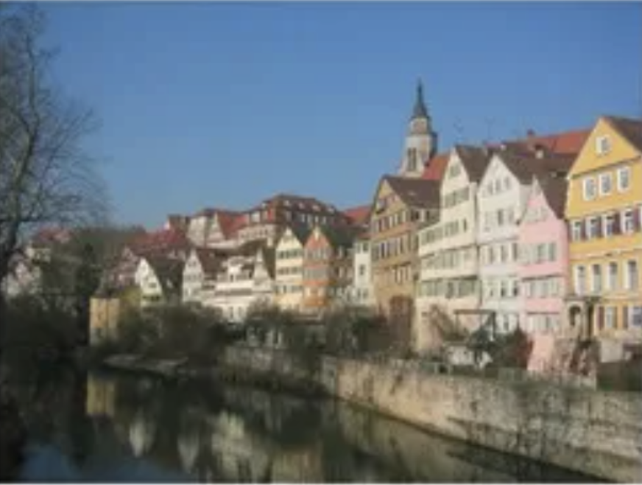
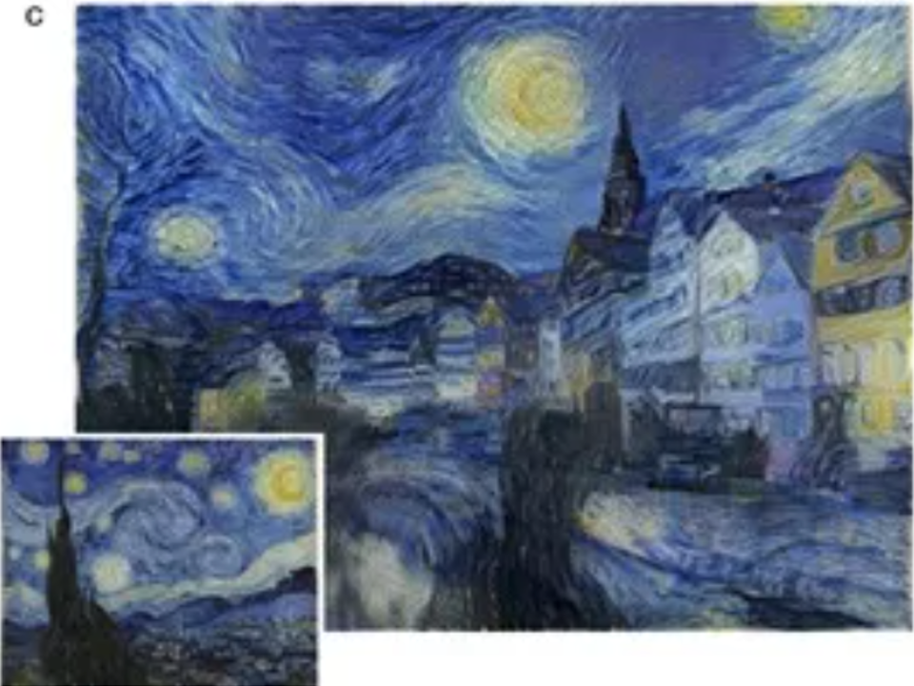




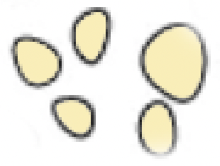
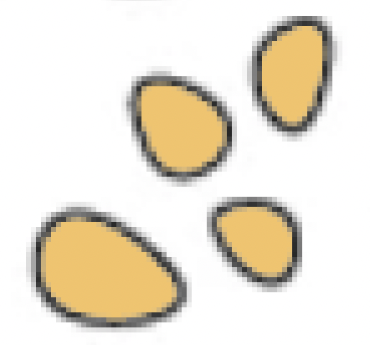
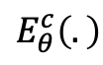


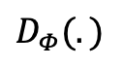
02
Summary
VAE
Style-transfer
$E_{θ}^{c}\left(.\right)$
$$D_{Φ}(.)$$
+
…
…
…
predict
$X^{ctrl}$
$$X^{perb}$$
perturbation
Source:Karras, T et al^{[4]}

Slide 13
PART 03
scPerb
研究内容

Slide 14
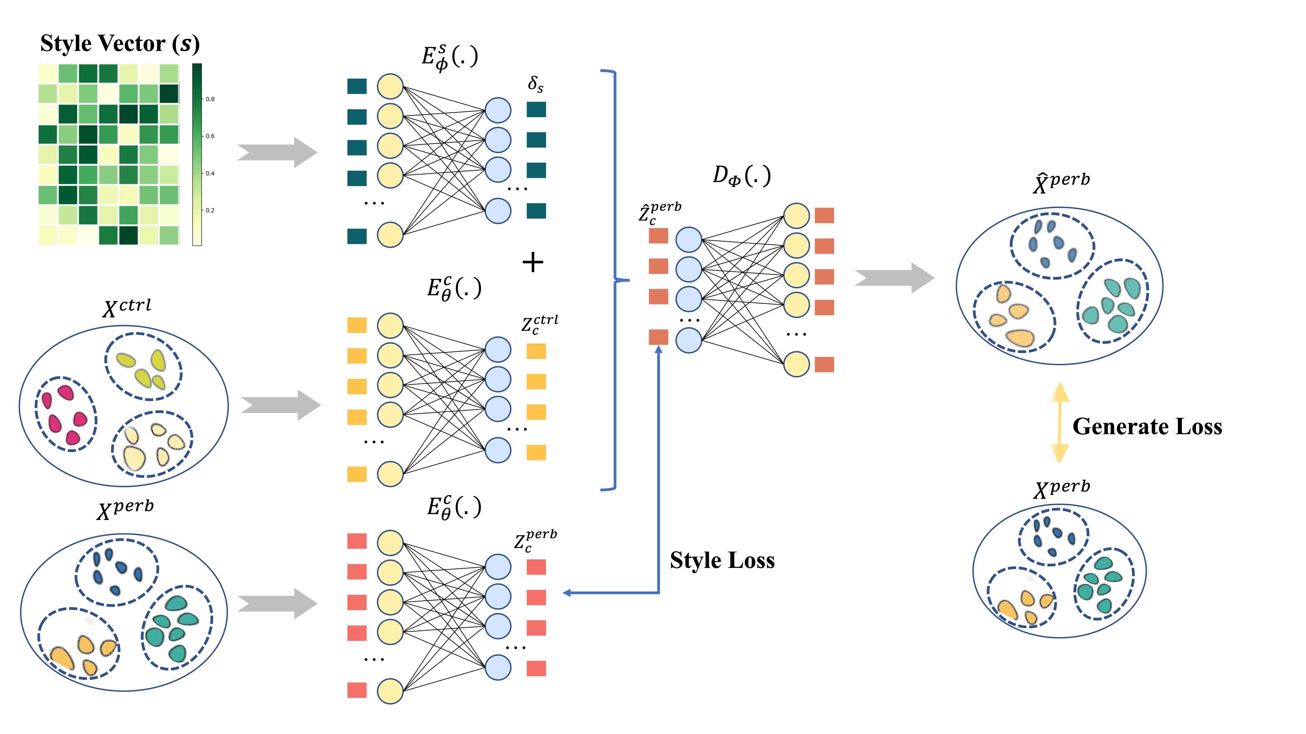
03
scPerb: Overview

Slide 15
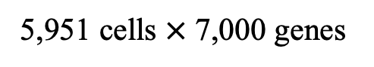
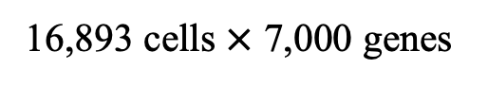
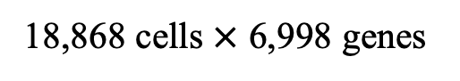
03
scPerb: datasets
18,868 cells $×$ 6,998 genes
5,951 cells $×$ 7,000 genes
16,893 cells $×$ 7,000 genes

Slide 16
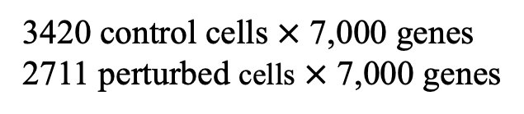
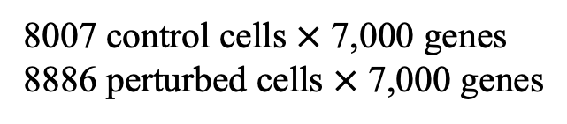
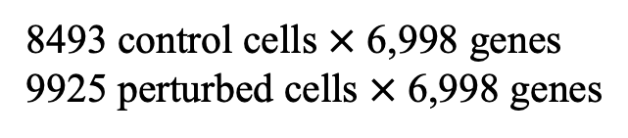
8493 control cells $×$ 6,998 genes
9925 perturbed cells $×$ 6,998 genes
03
scPerb: datasets
3420 control cells $×$ 7,000 genes
2711 perturbed cells $×$ 7,000 genes
8007 control cells $×$ 7,000 genes
8886 perturbed cells $×$ 7,000 genes

Slide 17
PART 04
results
实验结果

Slide 18
04
Results: comparison
Ours Model

Slide 19
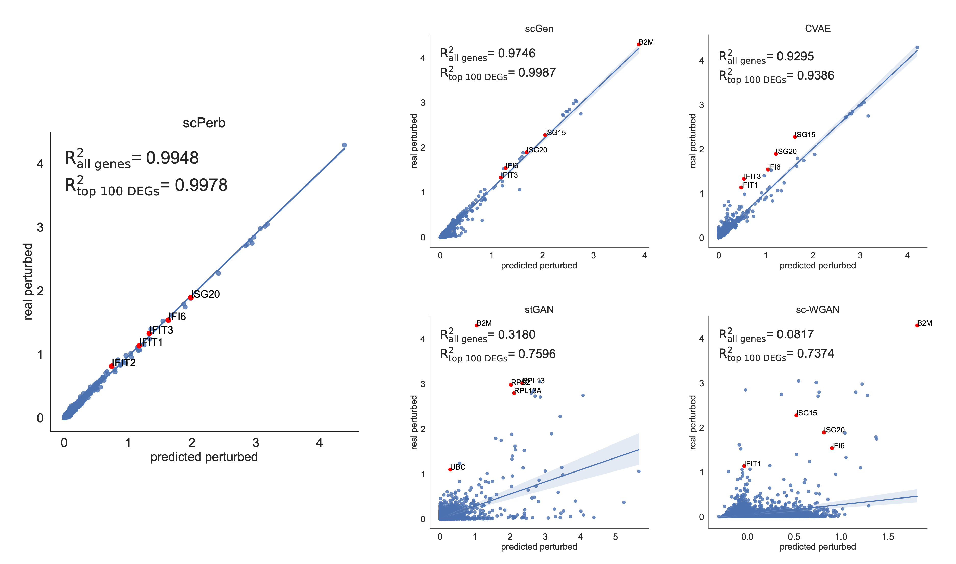
04
Results: PBMC-Kang dataset
scGen
CVAE
scPerb(ours)
stGAN
sc-WGAN

Slide 20
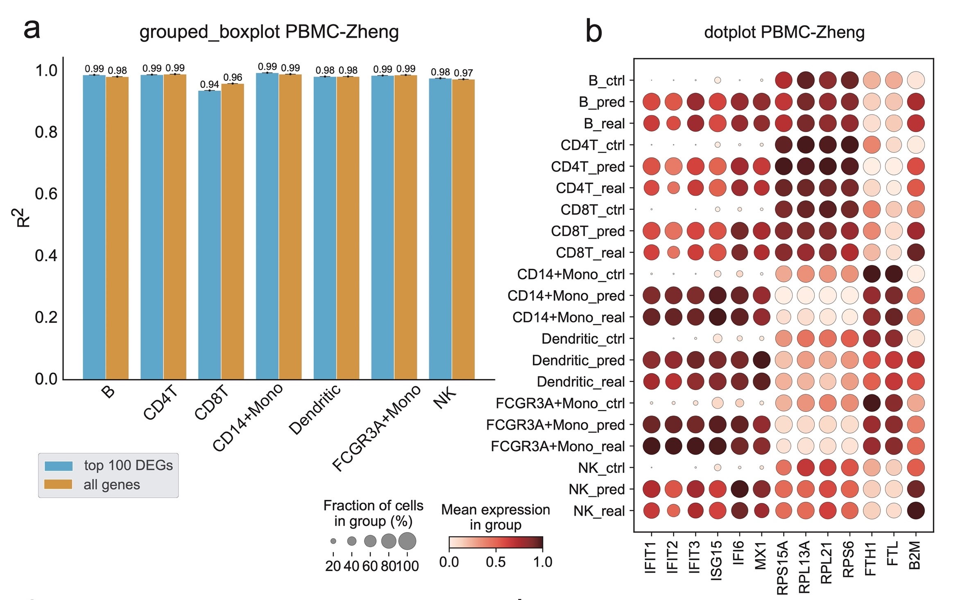
04
Results: PBMC-Zheng dataset

Slide 21
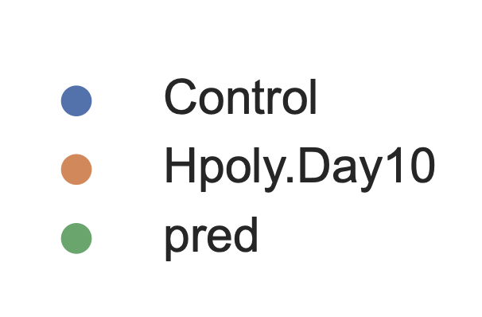
04
Results: Hpoly Dataset
CVAE
stGAN
scPerb(ours)
scGen
sc-WGAN

Slide 22
PART 05
Future
未来展望

Slide 23
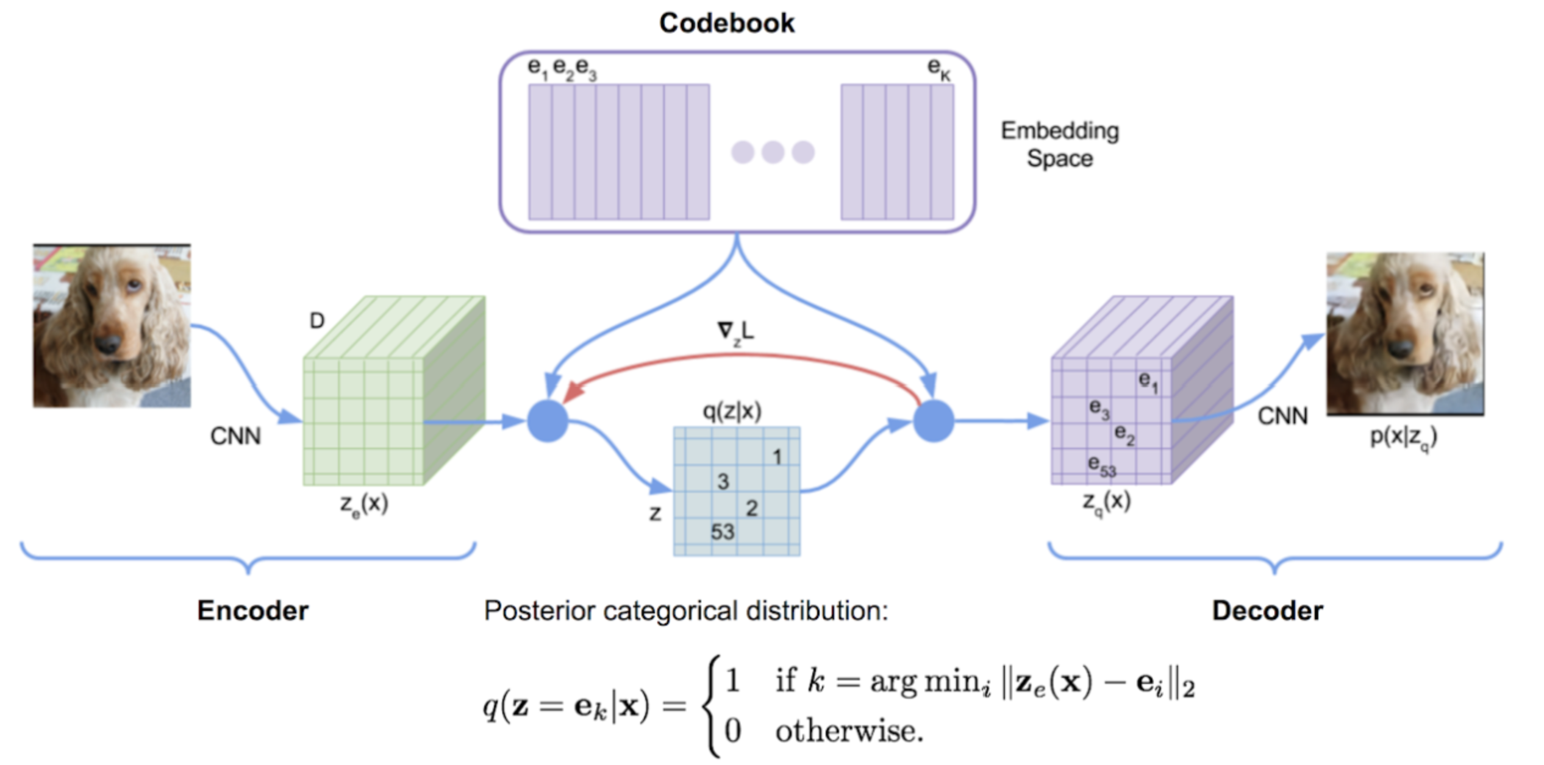
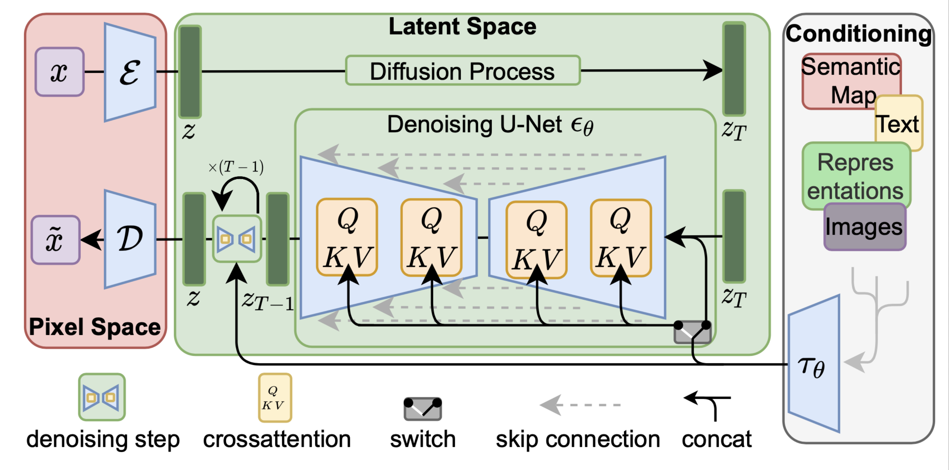
05
Future
Next step of our model…
VQVAE
Diffusion model
Source:Rink, N.A., et al.^{[8]}
Source:Rombach, R., et al.^{[9]}

Slide 24
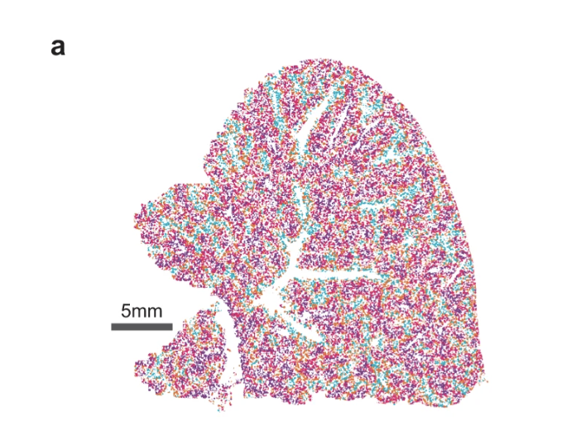
05
Future
Next step…
In the real world, cells are not isolated.
They form structures called tissues.
Spatial Transcriptomics
The Spatial Transcriptomics technique enables the use of cell image + gene expression level as input.
Providing information on the location of cells.
Spatial Perturbation Prediction could predict:
The reaction of cells after perturbation.
This method may trigger breakthroughs in fields such as tissue cell function, microenvironment interaction, developmental process lineage tracking, and disease pathology.
Source: Tang, Z et al.^{[10]}

Slide 25
06
References
Perturbation：Hsiue E H C, Wright K M, Douglass J, et al. Targeting a neoantigen derived from a common TP53 mutation[J]. Science, 2021, 371(6533).
scGen: Lotfollahi, M., F.A. Wolf, and F.J. Theis, scGen predicts single-cell perturbation responses. Nature Methods, 2019. 16(8): p. 715-721.
sc-WGAN: Ghahramani, A., F.M. Watt, and N.M. Luscombe, Generative adversarial networks uncover epidermal regulators and predict single cell perturbations. bioRxiv, 2018: p. 262501.
stGAN: Karras, T., S. Laine, and T. Aila. A style-based generator architecture for generative adversarial networks. in Proceedings of the IEEE/CVF conference on computer vision and pattern recognition. 2019.
Pbmc-Zheng dataset: Zheng, G.X., et al., Massively parallel digital transcriptional profiling of single cells. Nature communica- tions, 2017. 8(1): p. 14049.
Pbmc-Kang dataset: Kang, H.M., et al., Multiplexed droplet single-cell RNA-sequencing using natural genetic variation. Nature biotechnology, 2018. 36(1): p. 89-94.
Hpoly dataset: Haber, A.L., et al., A single-cell survey of the small intestinal epithelium. Nature, 2017. 551(7680): p. 333-339.
VQVAE: Rink, N.A., et al., Memory-efficient array redistribution through portable collective communication. arXiv preprint arXiv:2112.01075, 2021
Diffusion model: Rombach, R., et al. High-resolution image synthesis with latent diffusion models. in Proceedings of the IEEE/CVF conference on computer vision and pattern recognition. 2022.
Spatial: Tang, Z., Li, Z., Hou, T. et al. SiGra: single-cell spatial elucidation through an image-augmented graph transformer. Nat Commun 14, 5618 (2023).

Slide 26
2023
Thanks for listening!
2023 丘成桐中学科学奖计算机组答辩
演讲者：汤子嘉 时间：2023.12

Slide 27
Q&A

Slide 28
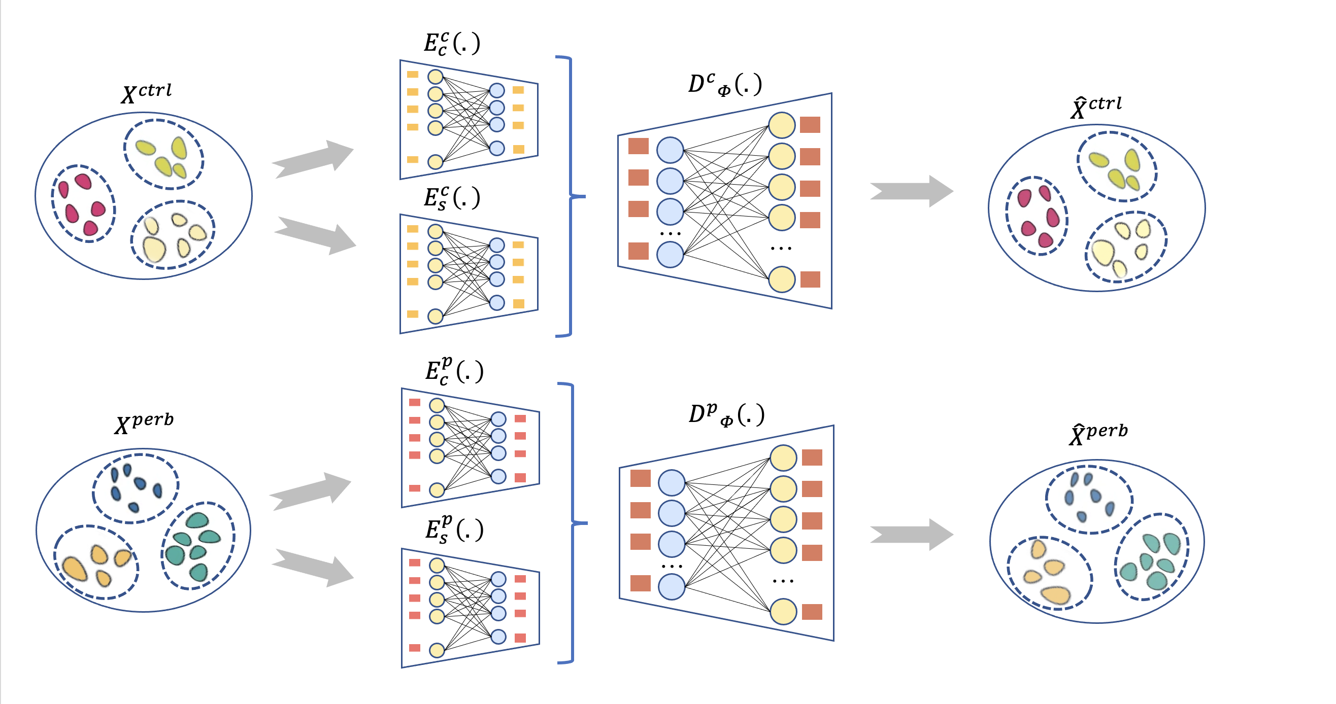
07
Appendix

Slide 29
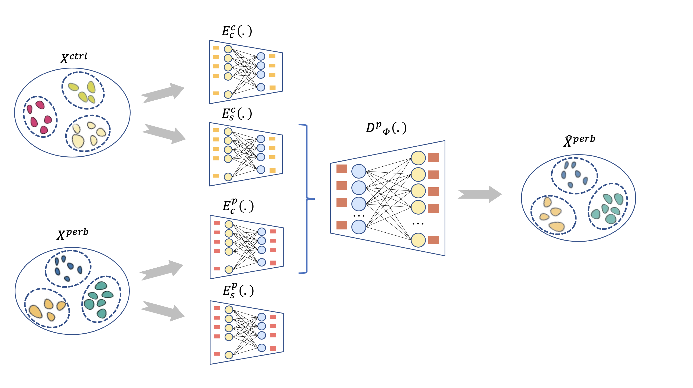
07
Appendix

Slide 30
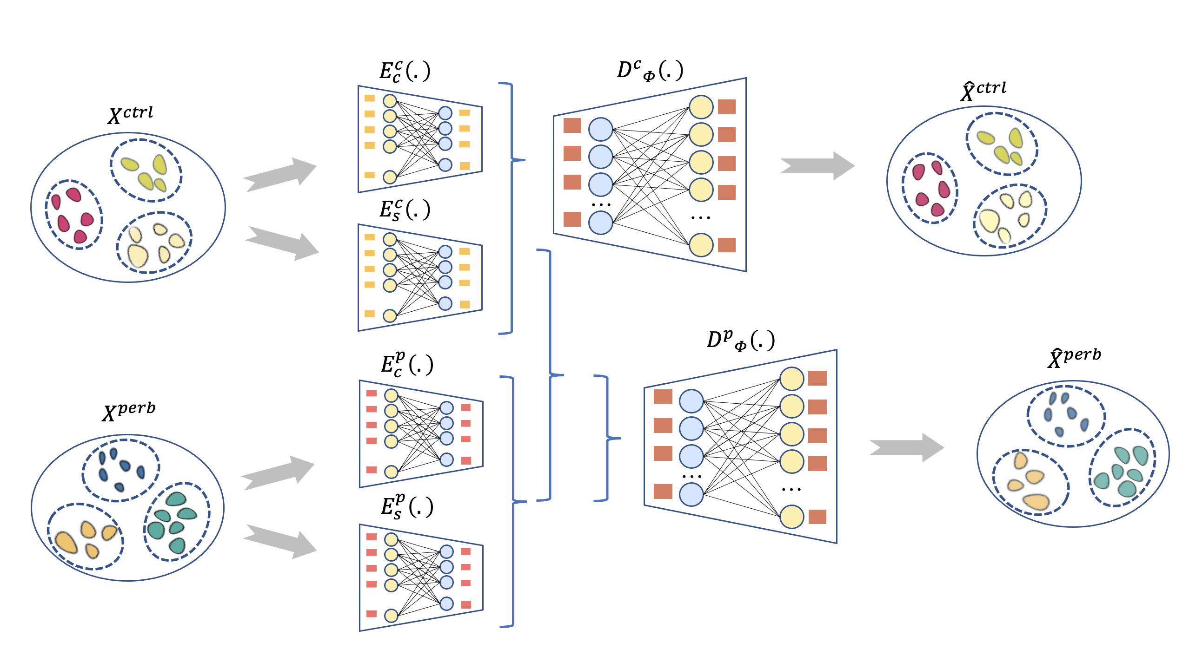
07
Appendix

Slide 31
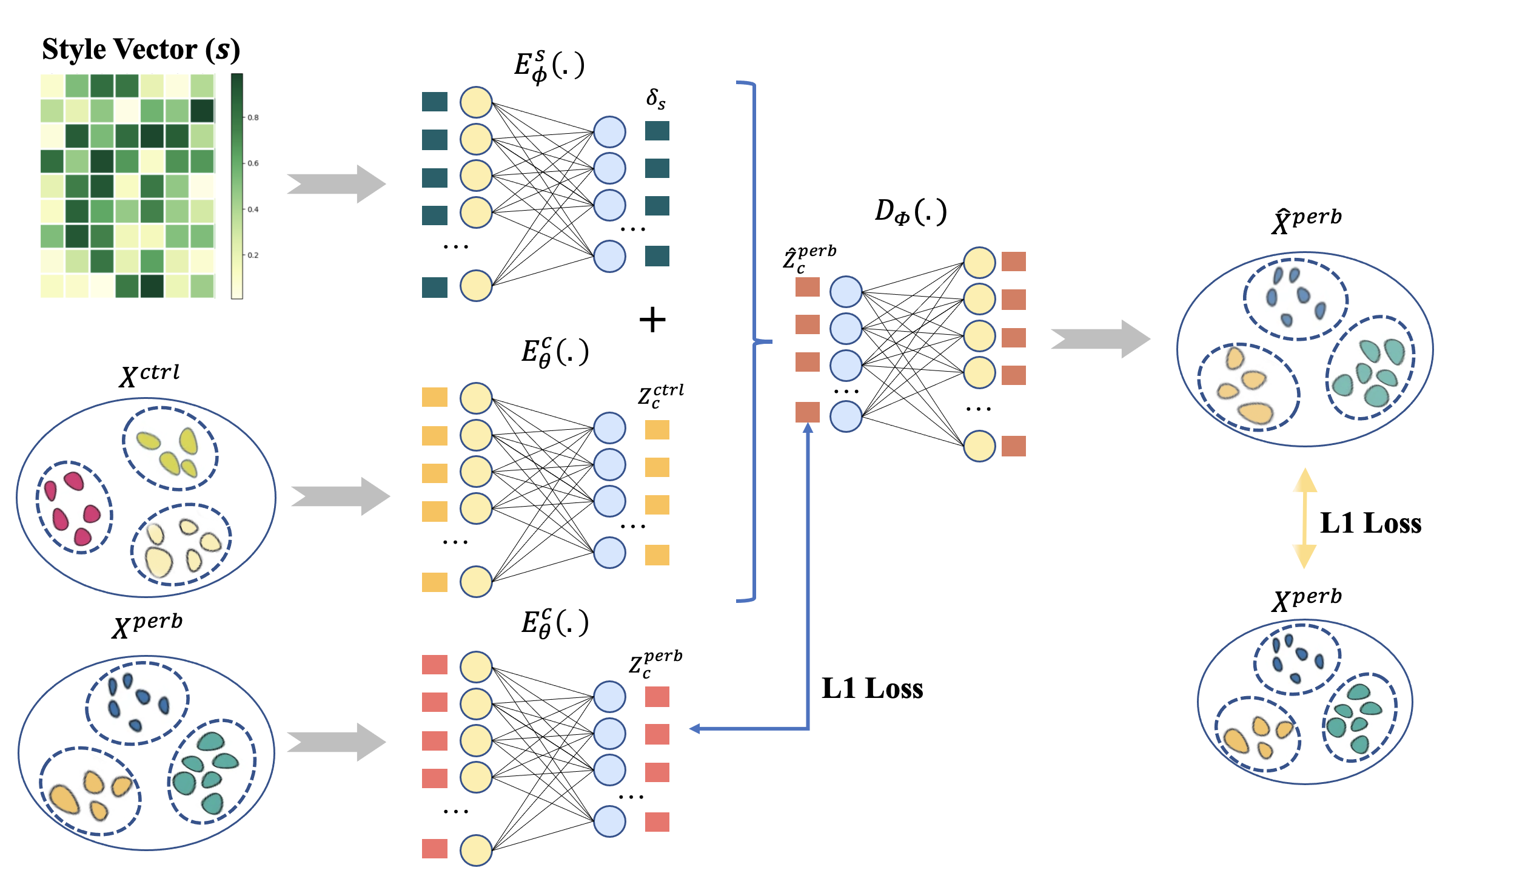
07
Appendix

Slide 32
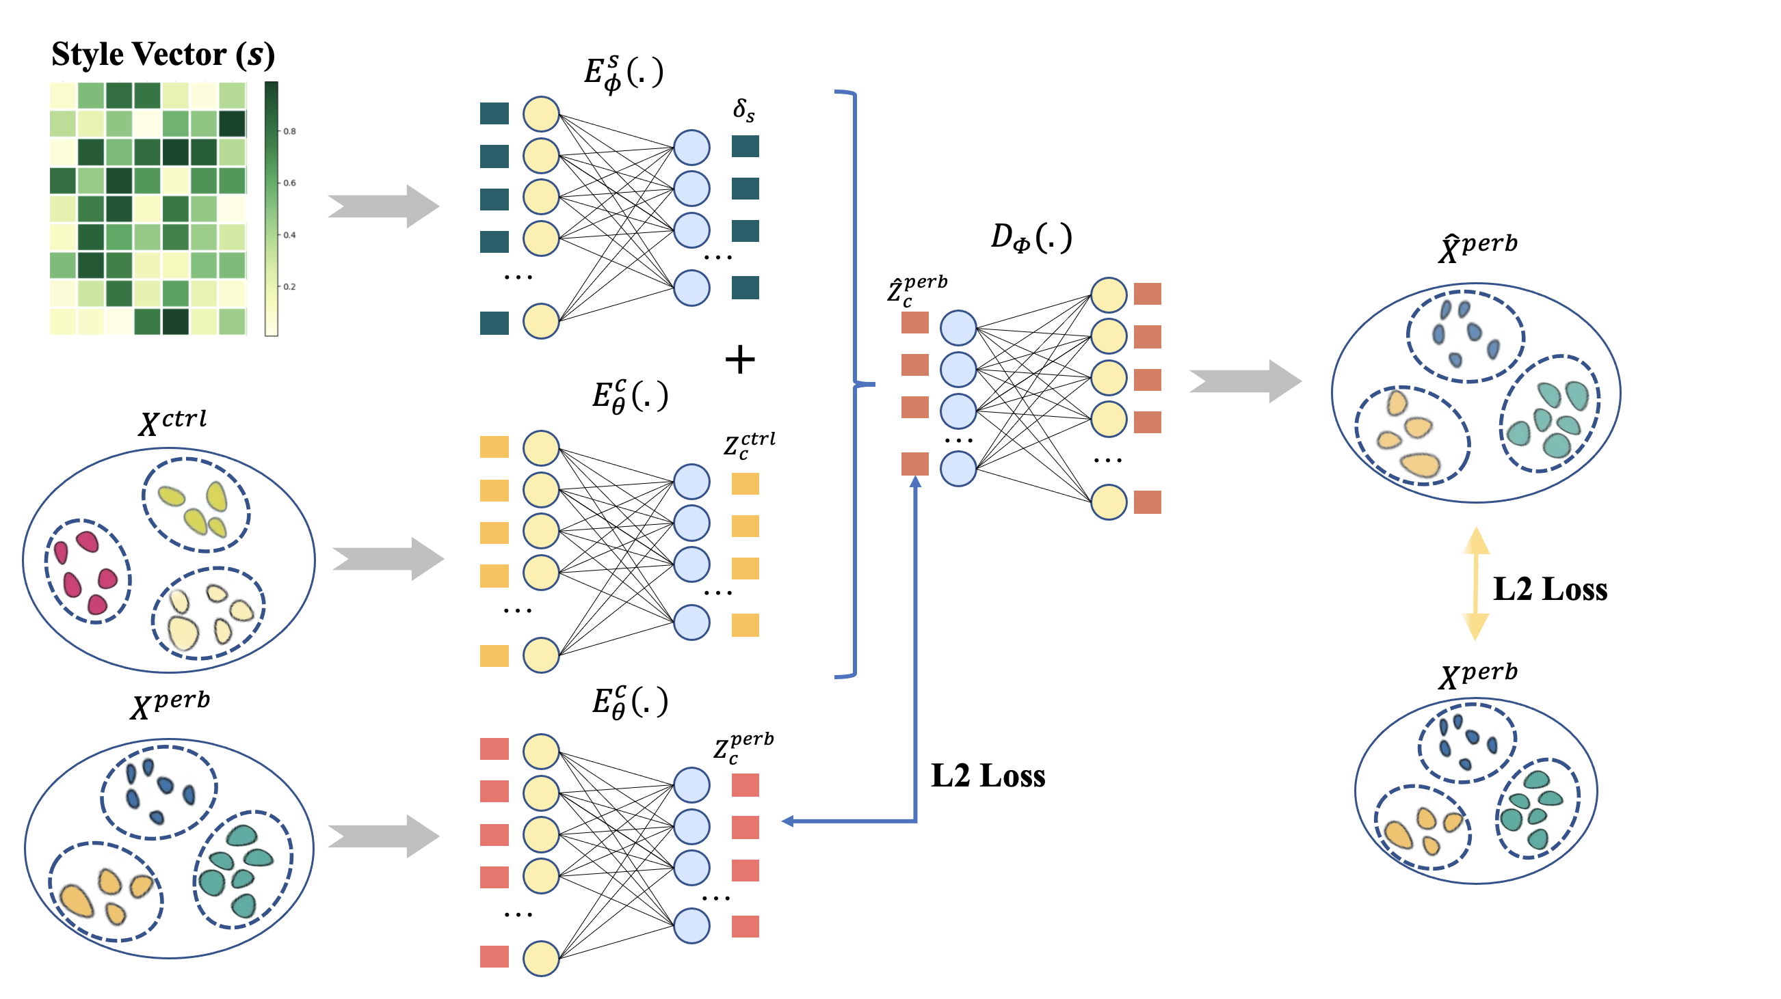
07
Appendix

Slide 33
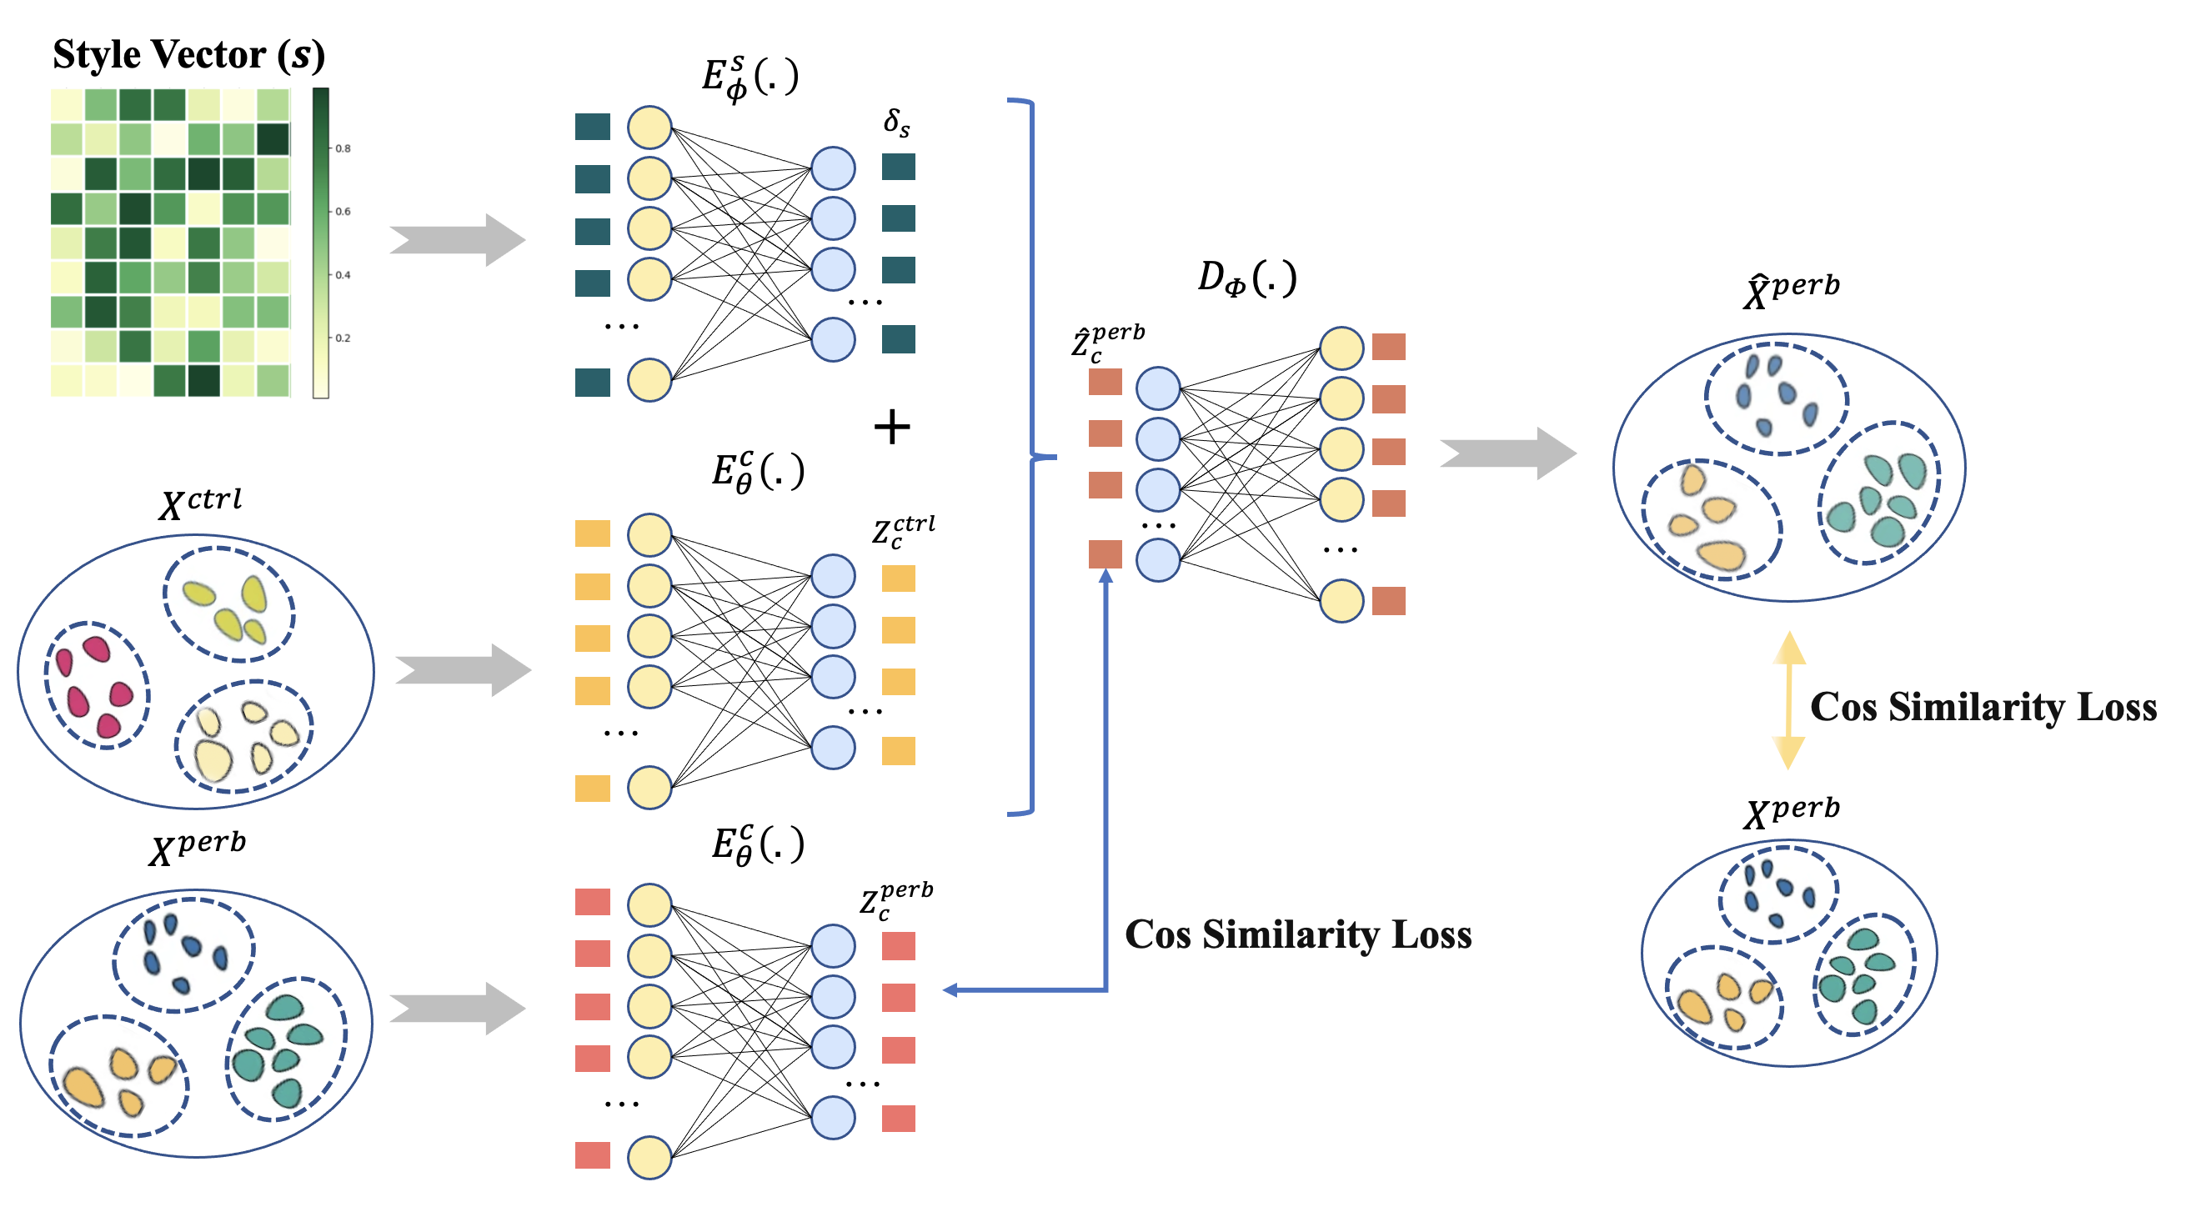
07
Appendix

